Slide 1



LLMs in the wilderness: Leveraging the power of LLMs in our business
Ali Najafi
VBYO 2025
1

Slide 2
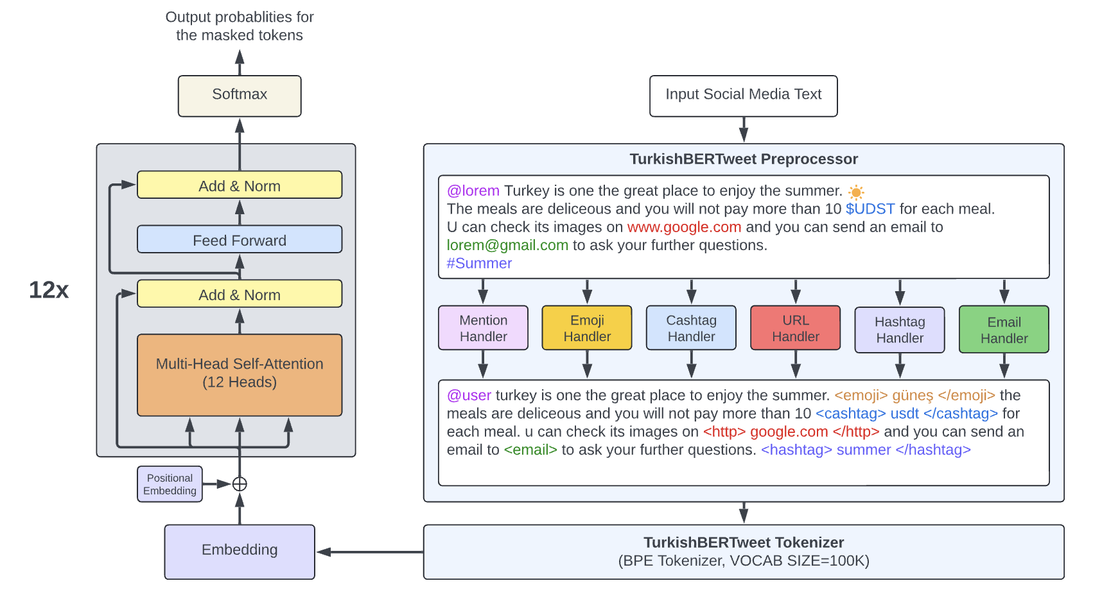




Ali Najafi
PhD in Computer Science, Sabancı University, 2024–Present
MSc in Computer Science, Sabancı University, 2022–2024
🌐 najafi-ali.com
Published Works:
🔥 Turkishbertweet: Fast and reliable large language model for social media analysis
🚫 VRLLab at HSD-2Lang 2024: Turkish hate speech detection online with TurkishBERTweet
📂 First public dataset to study 2023 Turkish general election
On going Projects:
🧩 Social Media Data Adaptors: Standardization and Anonymization of Social Network Datasets
🔍 Cross-Platform Bot Detection via Modeling of Social Media Account Behavior
📊 Analyzing the Impact of Voting Agency Discrepancies on Social Media Discourse During Turkey’s 2023 Election Nights

Slide 3
By the end of this session, You will know
How to approach an NLP project
What resources exist
What the pros and cons of LLMs are
How to apply models to a real project
How realistic the LLM-Hype is
How to finetune generative Language models

Slide 4

Hands on Project
Project
Amazon company after witnessing the advances in the AI field, decides to develop a Chatbot for its customers to help them purchase shoes!
They recruited a Machine Learning Engineer to develop it!
They provided the details of their shoe products and their prices!
Now, let’s say you are the ML guy, how can you build such a system?

Slide 5

Let’s check out the data!
Project
The dataset is available at amazon-uk-shoes-dataset
The downloaded data is in JSON format!
Available information:
url: Link to the product
title: title of the product
asin: Product Unique ID
price: Price of the product
brand: Brand of the product
product_details: Details of product
breadcrumbs: a navigational aid that allows users to keep track of their current location on a website or interface
images_list: links of product images
features: features of product

Slide 6
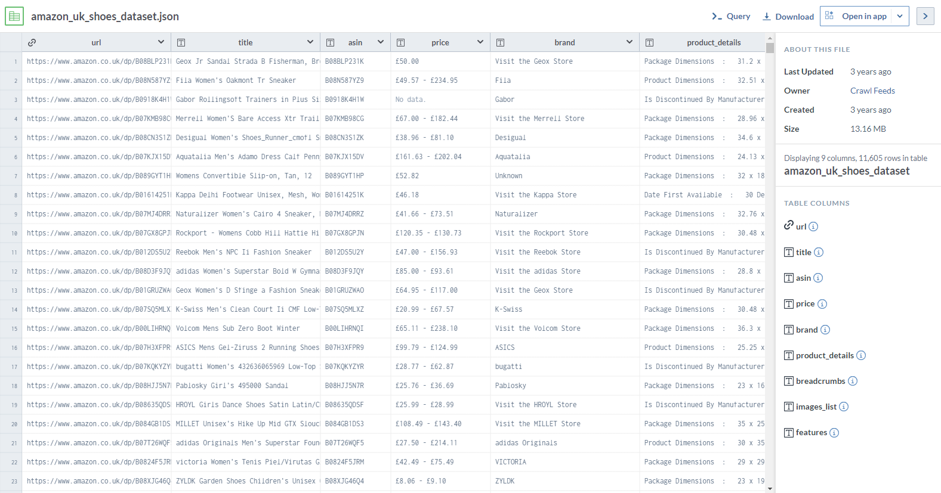
Project

Slide 7
NLP Tasks
Language Translation
EN -> TR, EN -> FA
Text Classification/Regression
Sentiment Analysis
Personality Detection
Topic Detection
Hate Speech Detection
Stance Prediction
Token Classification
Name Entity Recognition (NER)
Text Generation
Question Answering
Text Summarization

Slide 8
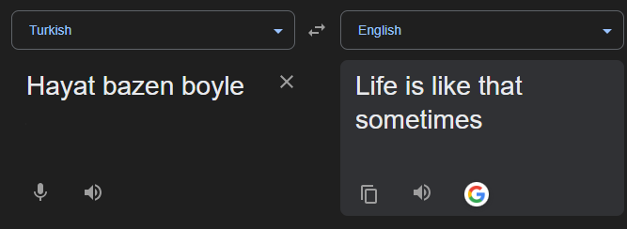
Language Translation

Slide 9
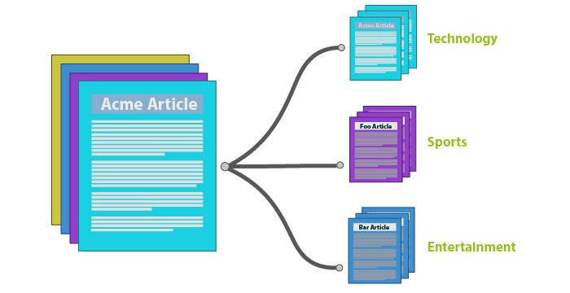
Text Classification

Slide 10
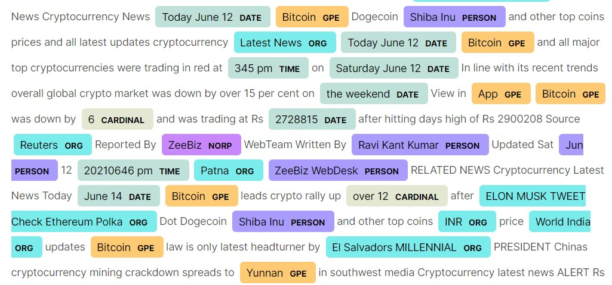
Token Classification

Slide 11
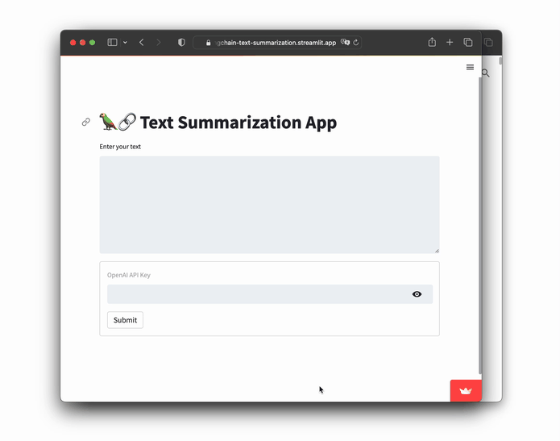
Text Summarization

Slide 12
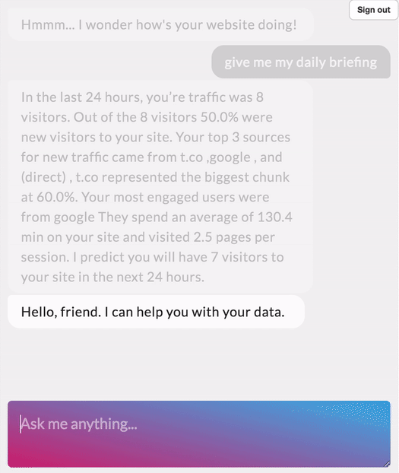
Question Answering

Slide 13


We should ask ourselves
Do we need LLMs?
Can we afford them?
Do we have access to skilled people?
Is the outcome significant enough to invest in them?

Slide 14

Which model?
There are many already pre-trained models available on Hugging Face
BUT Which model should I choose?
Several factors help us answer this question!
NLP Task
Computational Resources
Domain Requirement
LICENSE

Slide 15

NLP Task
If your task is other than text generation, Encoder models are available!
If your task contains generation, Encoder-Decoder OR Decoder models are available. Need to mention that you can still use these types of models for non-generative tasks as well!

Slide 16

Computational Resources
Computation power plays a great role in model selection.
Computation power means the GPU infrastructure of the company!
There are two main things about GPUs that we are interested in:
RAM
Speed

Slide 17

Domain Requirements
Each model has been trained on specific data for instance:
Internet Data
Code Data
...
In our project, models may have seen data about shoes, but they have no clue about the available products of Amazon company.
Language matters: If you are targeting customers of the UK, then the model needs to interact in English. What if you want a chatbot that can handle customers with different languages?

Slide 18

Terminologies in LLM World
Pre-Training: Training a language model from scratch
Finetuning: Training the pre-trained model on a domain-specific dataset(s)
Instruction Finetuned: The model is finetuned on a dataset that contains Question-Answer pairs.
Zero Shot: Using model without finetuning
Tokenizer Special tokens: Tokens that the tokenizer maps into a single ID.

Slide 19
Model Architectures and their objectives
________ models like ________ models can be trained on _______ objectives.
Encoder; BERT-based; classification or masked language modeling
Encoder-Decoder; T5-based; sequence-to-sequence or masked language modeling
Decoder; GPT-based; causal language modeling or masked language modeling

Slide 20
Language Modeling
Causal Language Modeling: predict the next token
Input: Hard work always pays _____.
Output: off
Masked Language Modeling: predict the masked token
Input: Hard work ____ pays off.
Output: always
Sequence to sequence: predict the corrupted tokens
Input: Hard ______ pays off.
Output: work always

Slide 21
Finetuning Approaches
Full-Finetuning: Updating directly the wights of the models
LoRA Finetuning: Just updating the LoRA adapter’s weights and keeping the model’s weights intact
RAG Finetuning: Finetuning with improved prompts using our knowledge database.
RLHF finetuning: Finetuning the model with a dataset based on human feedbacks using reinforcement learning

Slide 22
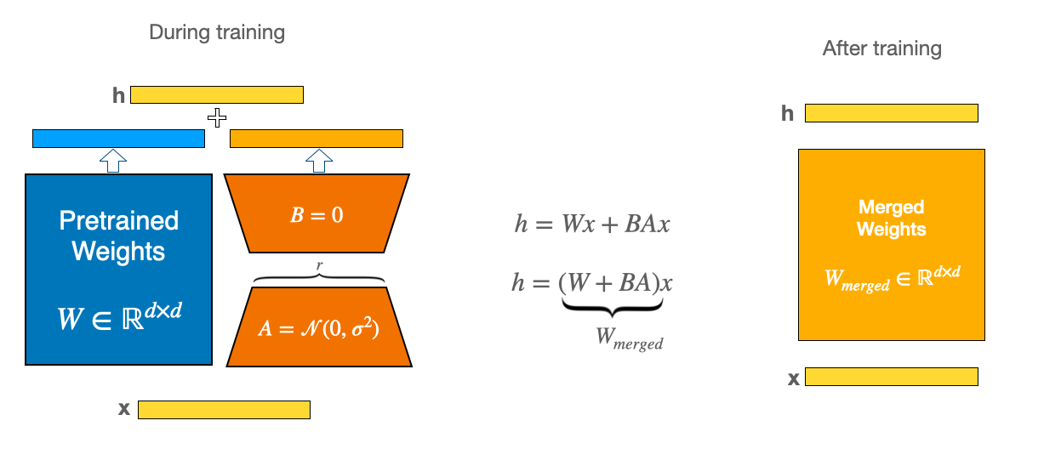
LoRA Finetuning
Hu, E. J., Shen, Y., Wallis, P., Allen-Zhu, Z., Li, Y., Wang, S., ... & Chen, W. (2021). Lora: Low-rank adaptation of large language models. arXiv preprint arXiv:2106.09685.

Slide 23
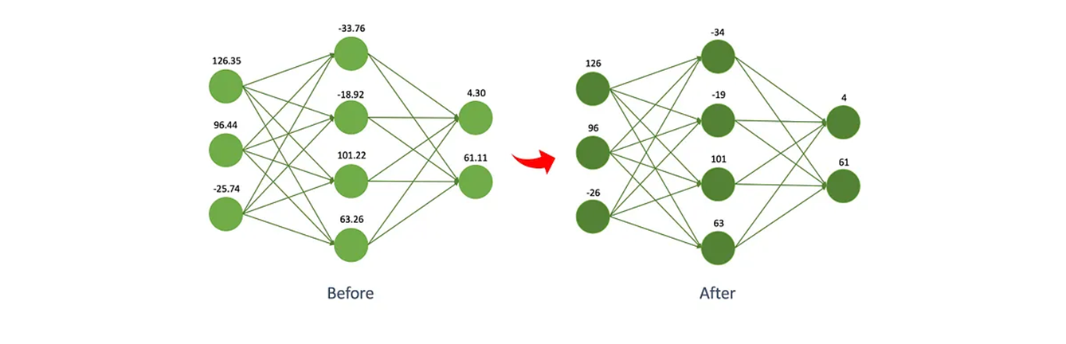
Quantization
It is not simply rounding the numbers!
It enables us to load huge models on our devices!
2bit
4bit
8bit
32bit
8bit

Slide 24
Libraries available for quantization
Bitsandbytes library of Huggingface
https://github.com/bitsandbytes-foundation/bitsandbytes
AWQ: Activation-aware Weight Quantization for LLM Compression and Acceleration
https://github.com/mit-han-lab/llm-awq
SeeDOT:
normally used in the IoT field
Developed by Microsoft
https://github.com/microsoft/EdgeML/tree/master/tools/SeeDot

Slide 25

Now we are ready to go!

Slide 26
What is Amazon expecting?
Project
A Chatbot that can interact with the customer and provide answers based on the provided data!
You may find an open-source chatbot that handles conversations very well but provides irrelevant information!
As a result, we need to customize our model!
Or in other words, finetune our model!

Slide 27

Let’s start!
Project
Resources:
https://huggingface.co/spaces/Vokturz/can-it-run-llm
Model Selection:
https://huggingface.co/models
Data Exploration
Data Preparation
Finetuning
Evaluation

Slide 28
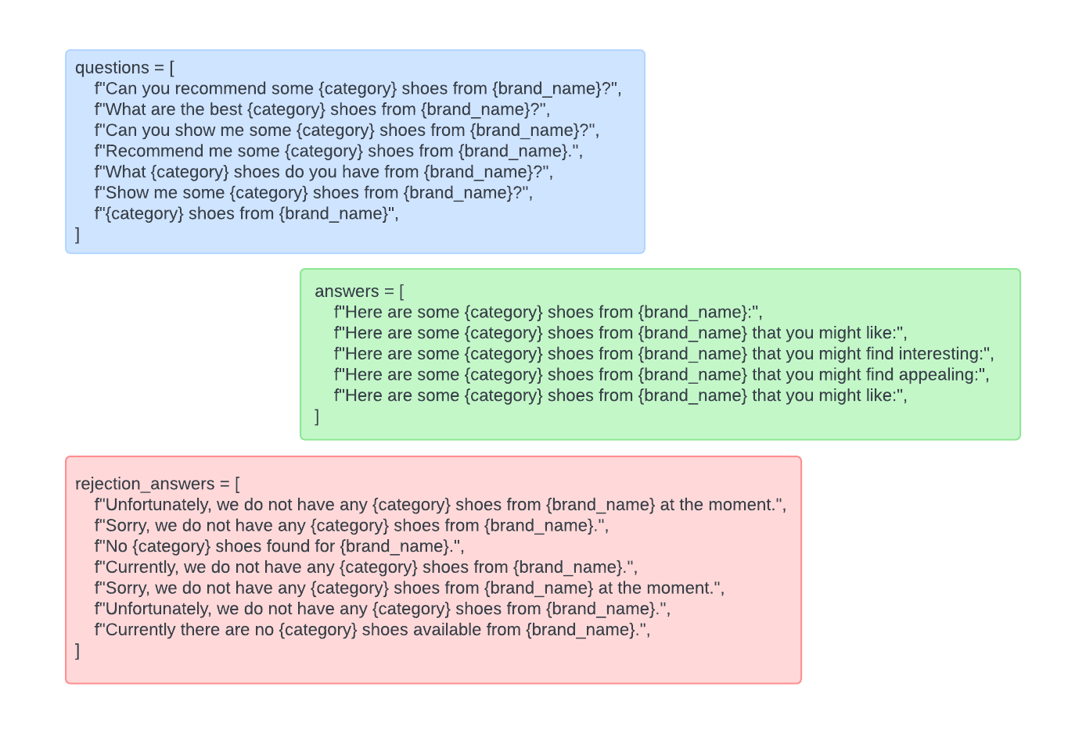
Finetuning Data Preparation
Project
So far, we have tabular data. To give a conversational taste to the communication between customers and the chatbot, we should transform our dataset into a textual conversational dataset.

Slide 29
🚀Deploying the LLMs
Transformers library is unfortunately slow, but it has a great programming interface and is great for finetuning.
As a result, for deploying LLMs, it is highly recommended to use libraries like vLLM or TGI.
The following web pages contain rich content about these libraries.
vLLM:
How does vLLM optimize the LLM serving system?
vLLM Doc
TGI:
Deploying Large Language Models With HuggingFace TGI

Slide 30

Thank you
ali.najafi@sabanciuniv.edu
www.najafi-ali.com

